Slide 1
PSTN Switching
Notes:
Let’s begin with another module called ‘PSTN Switching’…

Slide 2
Objectives
At the end of this session, you will be able to:
  Understand the need of switching and definition of switching
  Understand the notion of circuit switching and the role of switch in PSTN network
  Draw classification of switching and historical evolution in telecom switching
  Understand block schematic of a typical digital exchange
  Understand notion of time and space switching
  Understand steps followed in end-to-end telephone call
  Understand types of PSTN nodes and their interconnectivity
CONFIDENTIAL© Copyright 2008 Tech Mahindra Limited

Slide 3
Agenda
Switching and Switch
Classification of telecom switches
Digital exchange
Telephony: A typical end-to-end call flow
PSTN nodes and interconnectivity
CONFIDENTIAL© Copyright 2008 Tech Mahindra Limited

Slide 4
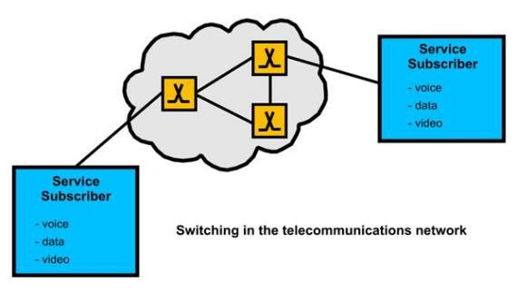
ITU-T Definition of Switching
The ITU-T defines switching as:
“The establishing, on demand, of an individual connection from a desired inlet to a desired outlet within a set of inlets and outlets for as long as is required for the transfer of information".
CONFIDENTIAL© Copyright 2008 Tech Mahindra Limited
Notes:
Here is a classical ITU-T definition of switching…

Slide 5
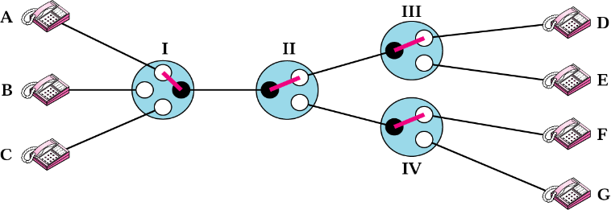
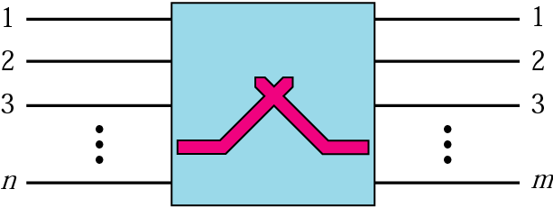
Circuit Switching
CONFIDENTIAL© Copyright 2008 Tech Mahindra Limited
Notes:
PSTN uses circuit switching where as computer network uses packet switching. Let’s understand , What is meant by circuit switching.
Circuit switching creates a direct physical connection between two devices. By moving the lever of the switches , any telephone on the left side can be connected to any telephone on the right side. To be very specific and perfect , circuit switching reserves resources between end to end entities. Resource in PSTN context is a time slot.
Circuit switch is a device with n inputs and m outputs that creates a temporary connection between input link and output link. The number of inputs does not have to match with number of outputs.
Circuit switching today either use either of two technologies : Space division switches OR time division switches.

Slide 6
Switching
Switch
  Device that sets up a communication path on demand and tears it down when it is no longer needed
Switching
  Routing information between different parties
Switches
Manual
Analog
Digital
Strowger
Crossbar
Time division
Space division
T & S
CONFIDENTIAL© Copyright 2008 Tech Mahindra Limited
Notes:
Switch …Device that sets up a communication path on demand and tears it down when it is no longer needed
The switching systems can be classified into three categories;
Manual - where all operation was manual
Analog - where operation was automatic but information transfer was analog
Digital switches where operation was automatic and information transfer was digital.

Slide 7
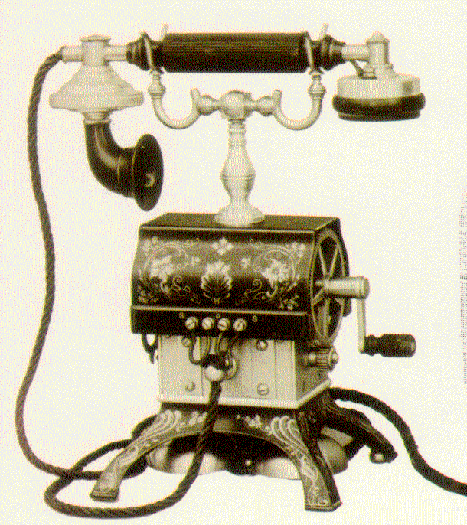
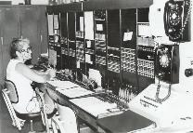
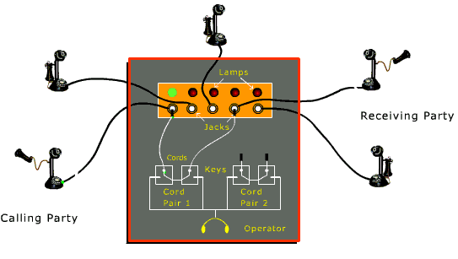

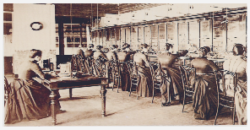
Manual Switching Systems
Manual Switching :
Conversation with
operator
CONFIDENTIAL© Copyright 2008 Tech Mahindra Limited
Notes:
Exchanges have undergone revolutionary change starting from Manual till today’s automatic electronic exchange/switch.
Beginning of this revolution started with Manual exchange wherein all operations carried out manually by human operators sitting in front of switch board especially dominated by women as seen in the figure.
But as the subscriber densities increased the need for automatic exchange was felt and strowger was the one who invented first ever automatic exchange which replaced human operators.

Slide 8
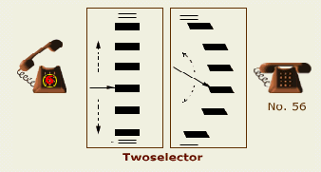
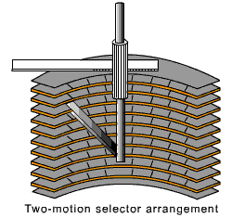
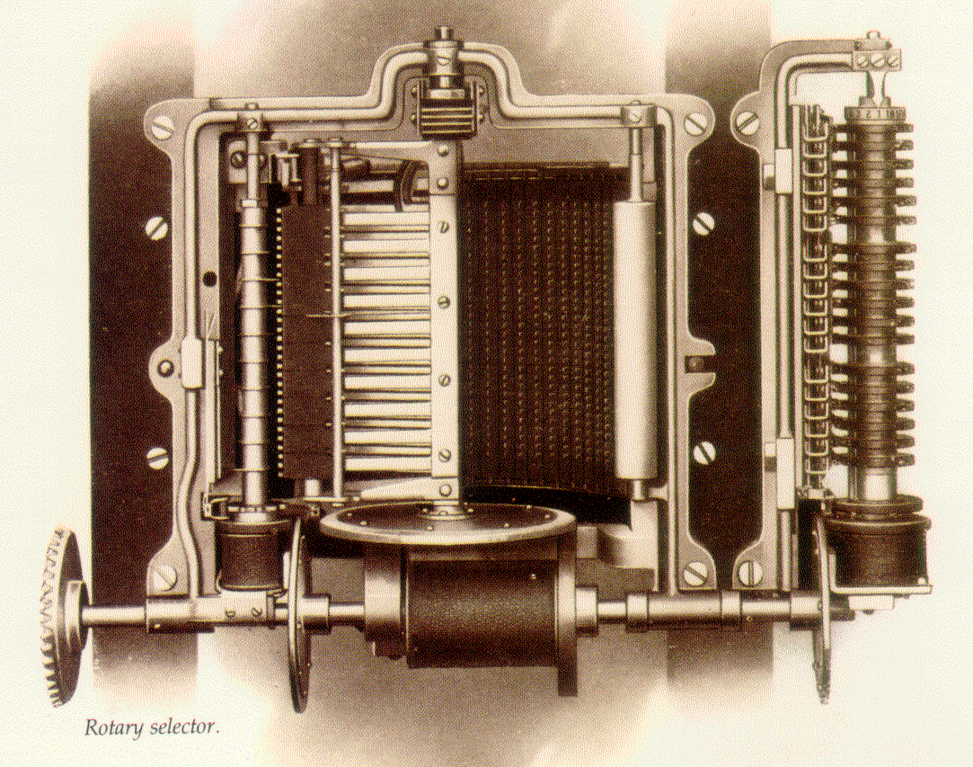
Strowger Switching System
CONFIDENTIAL© Copyright 2008 Tech Mahindra Limited
Notes:
The construction of strowger exchange involved two-motion selector as shown in the figure.
Selectors used are constructed using electromechanical rotary switches.
Exchange transmitted sound in the form of analog signals.
Since Strowger eliminated the operator, the calling customer must provide the pulses to drive the selector. The number of pulses in a train is equal to the digit value it represents except in the case of zero, which is represented by 10 pulses.
Operation :
When the digit 5 is dialed, five pulses are generated by the subscriber’s handset and transmitted to the strowger switch.
The switch then steps to level 5. and then subscriber dialed 6 wherein switch steps horizontally for the second digit dialled which in this case is 6 and connection is established.

Slide 9
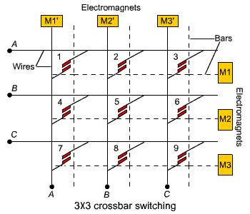
Crossbar Switching
Crossbar Switches by G. A. Betulander - designed using Common Control Concept
CONFIDENTIAL© Copyright 2008 Tech Mahindra Limited
Notes:
Disadvantages
Expensive relays
Noise due to chattering of delays
Limited capacity due to grid

Slide 10
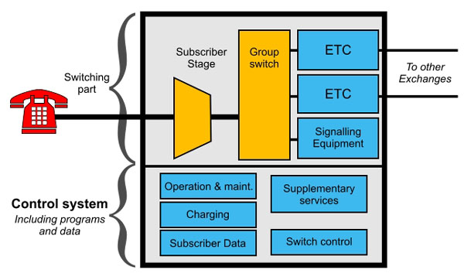
Electronic Exchange
CONFIDENTIAL© Copyright 2008 Tech Mahindra Limited
Notes:
Electronic Exchange or Digital switches are the one where operation are automatic and information transfer was digital.
Conversion of analog to digital and vice-varsa happens here. Information traversal between such exchanges in digital in nature.
Typical advantages of these type of changes are :1) Faster call setup and tear down, 2) Optimum utilization of resources , 3) better quality and error control

Slide 11
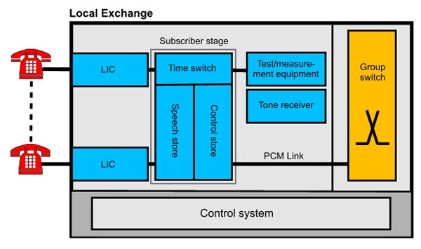
The Subscriber Stage
CONFIDENTIAL© Copyright 2008 Tech Mahindra Limited

Slide 12
Block Diagram of SLIC for a Digital Exchange
Two wire
Sub’s Line
Test
Access
Ringing
Battery
Feed
Overload
Protection
Test
Equipment
Ring
Trip
Off-Hook
Supervision
SLIC Functions
HYBRID
(BORSCHT Function)
B BATTERY FEED
O OVER VOLTAGE PROTECTION
R RINGING
S SUPERVISORY SIGNALLING
C CODING(CODEC)
H HYBRID
T TESTING
CODER
DECODER
TX
RX
Digital Switch
CONFIDENTIAL© Copyright 2008 Tech Mahindra Limited

Slide 13
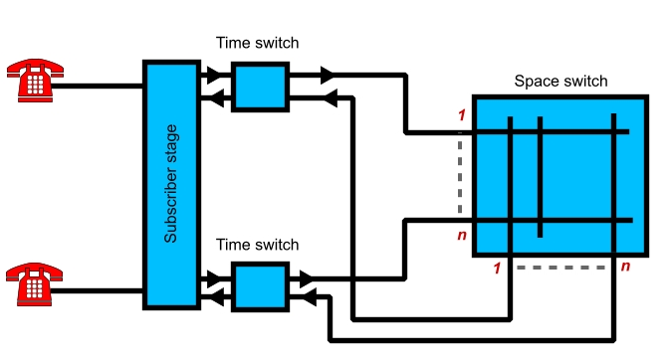
Time and Space Switch
CONFIDENTIAL© Copyright 2008 Tech Mahindra Limited
Notes:
Delete this slide…

Slide 14
Time Slot Interchange Time Switching Technique
1
2
24
1 2 24
1 2 24
Speech
memory
Read address
23
24
Control
memory
Write address
Time slot
counter
1
2
CONFIDENTIAL© Copyright 2008 Tech Mahindra Limited

Slide 15
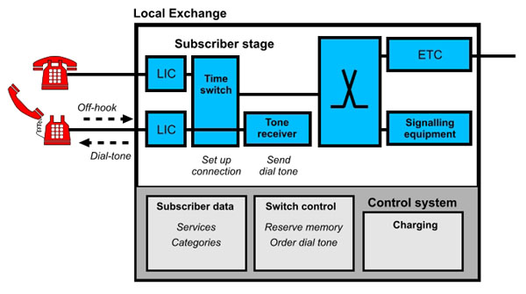
Phase 1: The A-subscriber lifts the handset
CONFIDENTIAL© Copyright 2008 Tech Mahindra Limited

Slide 16
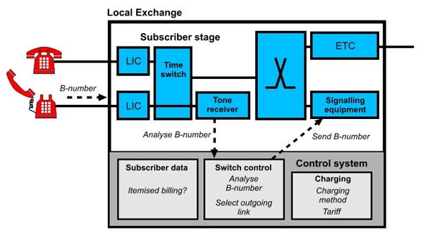
Phase 2: The exchange receives the B-subscriber number
CONFIDENTIAL© Copyright 2008 Tech Mahindra Limited

Slide 17
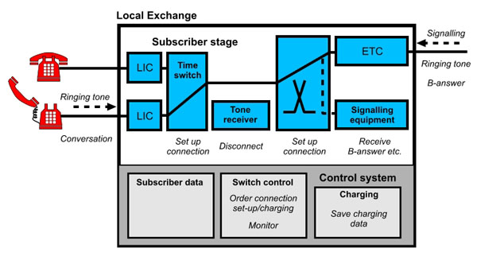
Phase 3: The exchange sets up the outgoing calls
CONFIDENTIAL© Copyright 2008 Tech Mahindra Limited

Slide 18
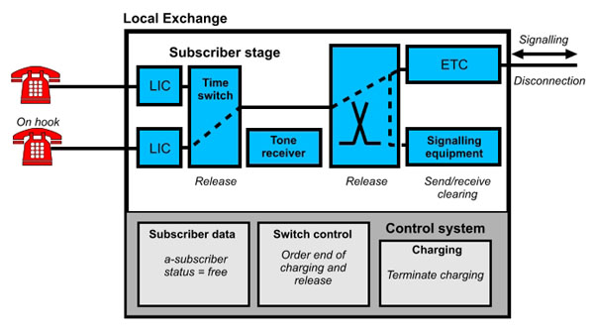
Phase 4: The subscribers conclude their conversation
CONFIDENTIAL© Copyright 2008 Tech Mahindra Limited

Slide 19
PSTN Nodes
PSTN nodes can be subdivided into three main categories:
  Local exchanges
  Transit exchanges
  International exchanges
CONFIDENTIAL© Copyright 2008 Tech Mahindra Limited
Notes:
PSTN nodes
PSTN nodes can be subdivided into three main categories: local exchanges, transit exchanges and international exchanges. Local exchanges are used for the connection of subscribers. Transit exchanges switch traffic within and between different geographical areas. International exchanges, and other gateway-type exchanges, switch traffic to telecommunications networks that belong to other operators.

Slide 20
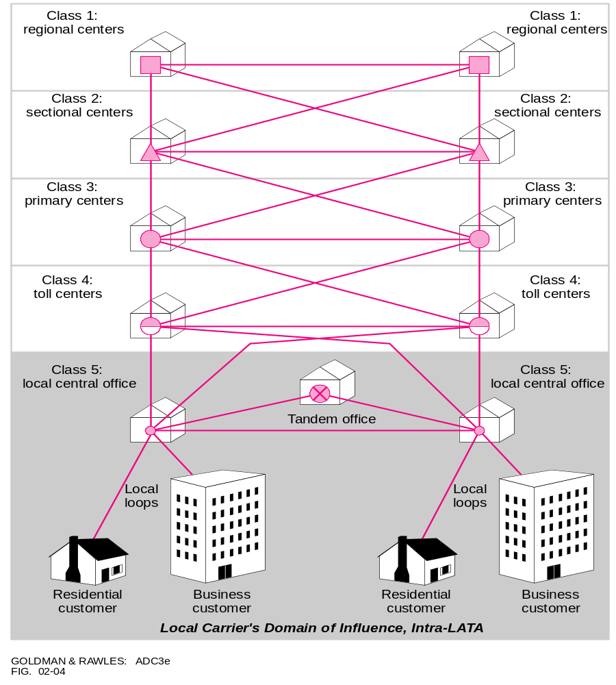
Exchange Hierarchy
E4/ T3 Links
Class 1
Higher traffic ,
higher switching speed ,
higher bandwidth
E1/ T1 Links
Class 5
Another look : Voice Network Heirarchy
CONFIDENTIAL© Copyright 2008 Tech Mahindra Limited
Notes:
This is another classification of exchange hierarchy. Theme is same names are changed.
Basic Principle remains same.
Higher is the level , higher is the load so is switching speed so is bandwidth requirement.

Slide 21
PSTN Network Architecture
Access
Tier 3
Access
2000 - 6500
nodes
MegaStream
Tier 3
Small towns
40,000
sites
& suburbs
Tier 2
Tier 2
500 nodes
Large towns
Tier 1
60 nodes
Tier 1
cities
CONFIDENTIAL© Copyright 2008 Tech Mahindra Limited

Slide 22
Summary
In this session, we have learned:
  Need of switching and definition of switching
  Notion of circuit switching and the role of switch in PSTN network
  Classification of switching
  Historical evolution in telecom switching
  Block schematic of a typical electronic exchange
  Time and space switching concept
  End-to-end telephone call: Step by step
  Types of PSTN nodes and their interconnectivity to form PSTN network architecture
CONFIDENTIAL© Copyright 2008 Tech Mahindra Limited

Slide 23
Thank You

